Slide 1
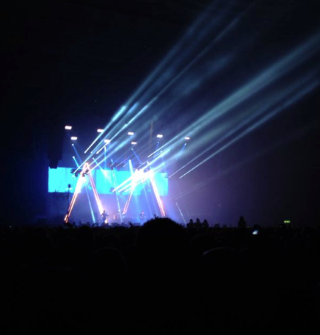
Front cover
Final version
Draft version

Slide 2
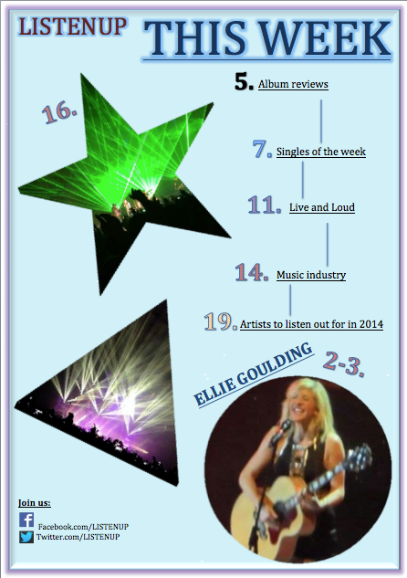
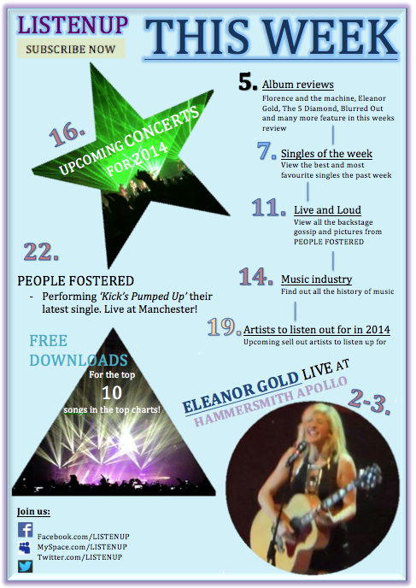
Contents page
Draft version
Final version

Slide 3
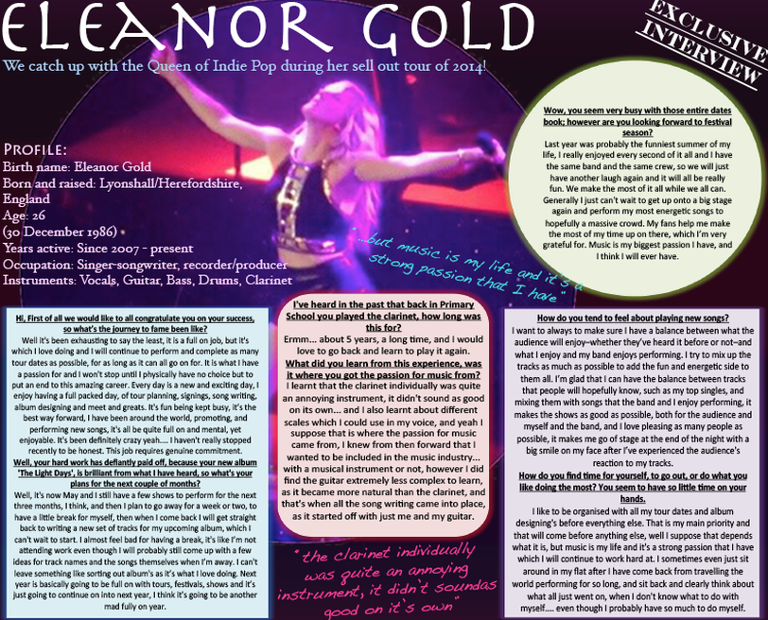
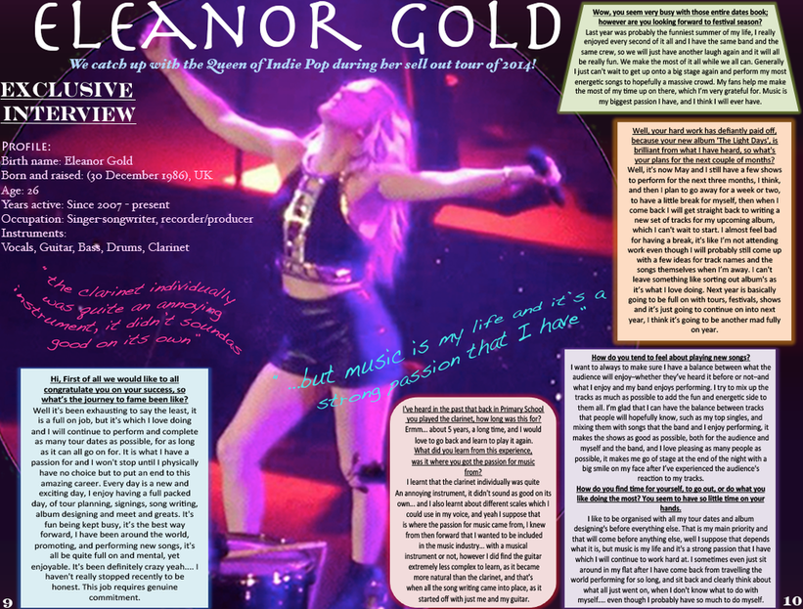
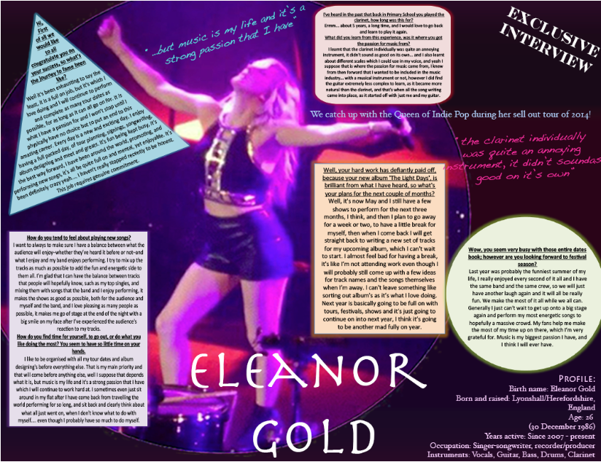
Double page spread
Final version
Draft versions

Slide 4
In what ways does your media product use, develop or challenge forms and conventions of real media products?
Front cover
Following conventions:
Title at the top
Headlines at the bottom and sides
One main focus image
Challenging conventions:
No spoilers e.g. quotes from articles on the front page
Contents page
Following conventions:
Format (list type)
More than one image
Sub-title heading
Challenging conventions:
No images with text
Double page spread
Following conventions:
Text boxes on interview around the page (attempt)
Separate chunks of information throughout article
Challenging conventions:
Using a wavy type of font on the quotes
Title

Slide 5
How does your media product represent particular social groups?
Easy language
Colour’s, fonts and styles
Specific interests
Target age group happily pay between £2.00-£2.50/£3.00
Affordable to my target audience as they may be in a working (part-time) situation
Magazine comes with a free poster and CD from the latest artist
Audience to receive latest music in an affordable way

Slide 6
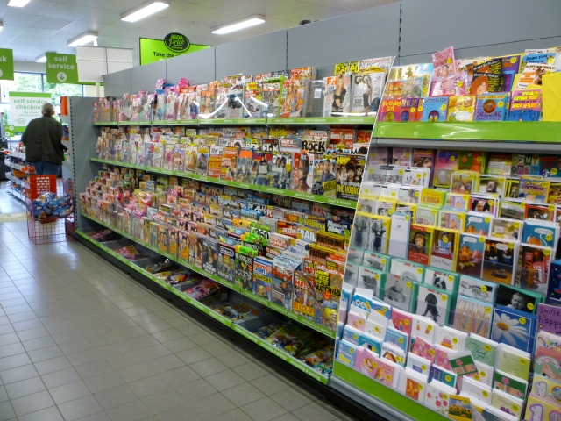
What kind of media institution might distribute your media product and why?
Supermarkets/local newsagents
Wide audience
Adds variety
Hard copy and online
More beneficial (travelling people, on the way to work)

Slide 7
Who would be the audience of your media product?
Early teens (15-17)
Situated in this age category
Know interests well
People who take an interest in Indie Pop music
Research showed:
Concerts
Interviews
Free gifts
Attractions:
Colours
Price
Offers
Titles

Slide 8
How did you attract /address your audience?
Through colours
Analysing which colours my target audience prefer on magazines.
Promotions (Unique selling point)
Free poster
CD
Exclusive interview with Eleanor Gold (famous icon)
Image
Connection
Easily relate
Live concert feel
Interested in
Language
Easy to read and understand
Wont put audience off

Slide 9
What have you learnt about technologies?
How to use Photoshop
Layers
Merging
- Merging layers, then saving the document, therefore I can’t edit it again
Alter images
Adjust positioning of texts (slanted)
Changing colours and fonts, styles

Slide 10
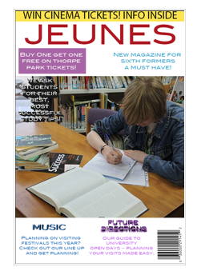
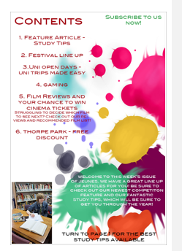
Looking back at your preliminary task, what do you feel you have learnt in the progression from it to the full product?
Using Photoshop
More independently
Professional look
More understanding and knowledge
Without basic look and feel
Cover and contents
Less simplistic format
Follows more conventions
Targets
Too much white on front cover
Image covering the whole of the background, so there are no gaps
Too many exclamation marks
- Decreased the use of them to create a more professional look

